Slide 1




My Solving Equations Interactive Notebook
$$×$$
2x =4
$$÷$$
a-4=7
$$−$$
$$y=17$$
Name
Class
Teacher: Mr Heptinstall
Term 3 Semester 2
x+5=9
2b+7=13
1

Slide 2
Contents
Glossary or Formula Page
Page
Date
Description
2
3

Slide 3
Let’s start with a Quickwrite
What algebra words can you remember?
Expression
Term
Coefficient
Constant
Pronumeral
Like Terms
Expand
Factorise
Evaluate
Simplify
3a + a + 4ab – 5ba + 3a² + 7

Slide 4

24
7
30
Date
Solving Equations
EQ – How do I find an unknown value in an algebraic equation?
What is a variable and how do we solve equations involving them?
Examples
A ______________ (or pronumeral) is a letter that represents an unknown number.
To solve an equation with a variable, we _________ the equation so our unknown value is by itself on one side of the equals sign. We do this by doing the inverse action.
x + 2 = 4
Think: Inverse of + is -
x + 2 = 4
-2 -2
x = 2
CHECK YOUR ANSWER!!
2+2=4
x ÷ 3 = 4
Think: Inverse of ÷ is x
x ÷ 3 = 4
x3 x3
x = 12
CHECK YOUR ANSWER!!
12 ÷ 3 = 4
The inverse functions are:
+ -
+
x ÷
÷ x
If you do something on one side of the equals sign, do it on the other!

Slide 5
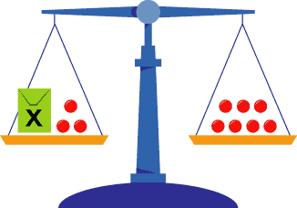
Consider this
Another great way to think about it is with balance scales.
x + 3 = 7
– 3 – 3
x = 4

Slide 6

Do you understand? Fists of Five
Notes:
Check for Understanding

Slide 7

Let’s try some together
a) m + 3 = 8 b) g – 16 = 11 c) w × 6 = 24
d) k ÷ 5 = 9 e) 7v = 28 f)
$\frac{d}{4}$ = 48

Slide 8

Tasks
24
7
30
Essential Question
Complete the following tasks on this side (left) of your page
Questions
Notes
Summary
Have YOU been doing your summaries?
Your book, your responsibility!

Slide 9
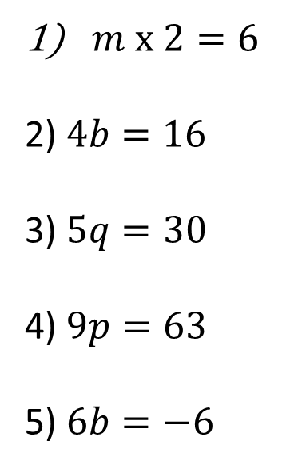
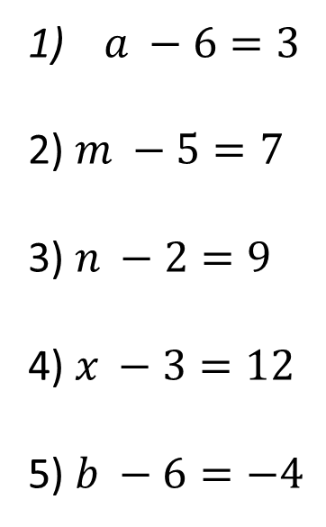
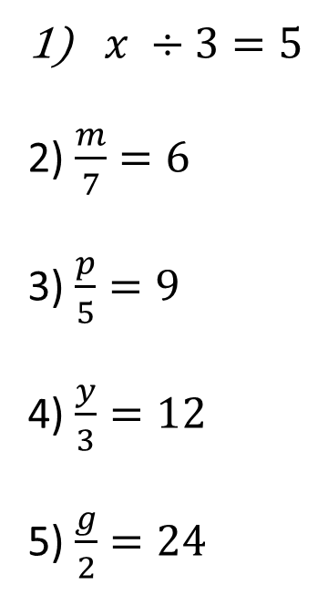
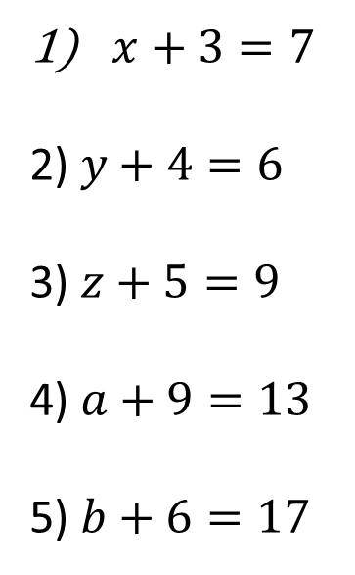
Now your turn!
Set 1 Set 2 Set 3 Set 4
$x+3=7$
2) $y+4=6$
3) $z+5=9$
4) $a+9=13$
5) $b+6=17$
$a −6=3$
2) $m −5=7$
3) $n −2=9$
4) $x −3=12$
5) $b −6=−4$
$m x 2=6$
2) $4b=16$
3) $5q=30$
4) $9p=63$
5) $6b=−6$
$x ÷3=5$
2) $\frac{m}{7}=6$
3) $\frac{p}{5}=9$
4) $\frac{y}{3}=12$
5) $\frac{g}{2}=24$

Slide 10
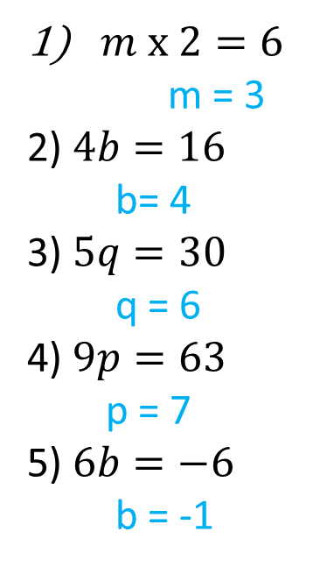
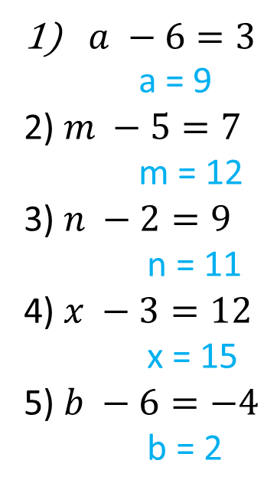
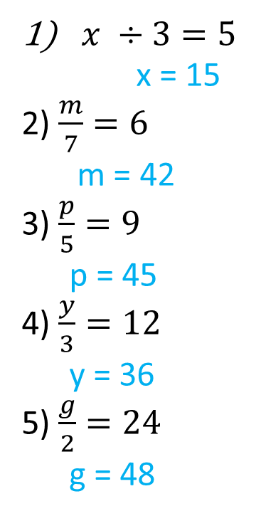
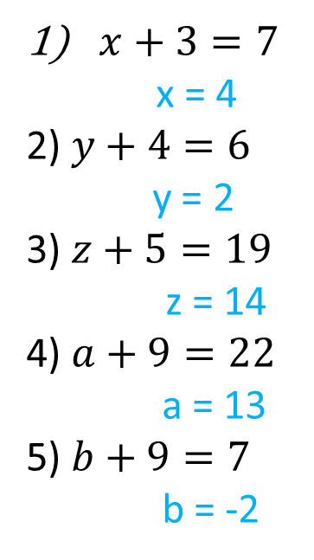
Answers!
Set 1 Set 2 Set 3 Set 4
$x+3=7$
x = 4
2) $y+4=6$
y = 2
3) $z+5=19$
z = 14
4) $a+9=22$
a = 13
5) $b+9=7$
b = -2
$a −6=3$ a = 9
2) $m −5=7$
m = 12
3) $n −2=9$
n = 11
4) $x −3=12$
x = 15
5) $b −6=−4$
b = 2
$m x 2=6$
m = 3
2) $4b=16$
b= 4
3) $5q=30$
q = 6
4) $9p=63$
p = 7
5) $6b=−6$
b = -1
$x ÷3=5$ x = 15
2) $\frac{m}{7}=6$
m = 42
3) $\frac{p}{5}=9$
p = 45
4) $\frac{y}{3}=12$
y = 36
5) $\frac{g}{2}=24$
g = 48

Slide 11
Notes Review
24, 7 ,30
Date
Title
Essential question
Notes complete
Notes complete with colour and diagrams
Questions completed
Contents page filed in
Formula page filled in

